Slide 1
Data 601 Project Presentation
Gautham Nagaraj Chandra Shekariah
Romith Bodanda
Lamis

Slide 2
The dataset: Obtained from IEEE-dataport.org
This dataset of breast cancer patients was obtained from the 2017 November update of the SEER Program of the NCI
Provides information on population-based cancer statistics
The dataset involved female patients with breast cancer diagnosed in 2006-2010
Patients with unknown tumor size, were less than 1 month were excluded; thus, 4024 patients included

Slide 3
Why use this dataset?
The dataset is uploaded to IEEE-dataport which allows the public to use the data
The dataset does not contain any information regarding the patient, like the name or complete address; thus, upholding the law of data privacy
The columns of the data set contain medical terminologies which cannot be understood by layman; It will be up to the project group to research and explain these terms, which will better our understanding

Slide 4
What are the guiding questions
What are the demographic factors; like age, race, marital status that affect/do not affect the survival rate of these patients
How do the tumor characteristic; such as size, grade, hormone-receptor status correlate with the survival outcome
We hope to tackle these questions and get a better understanding on what the common misbeliefs or misunderstandings are

Slide 5
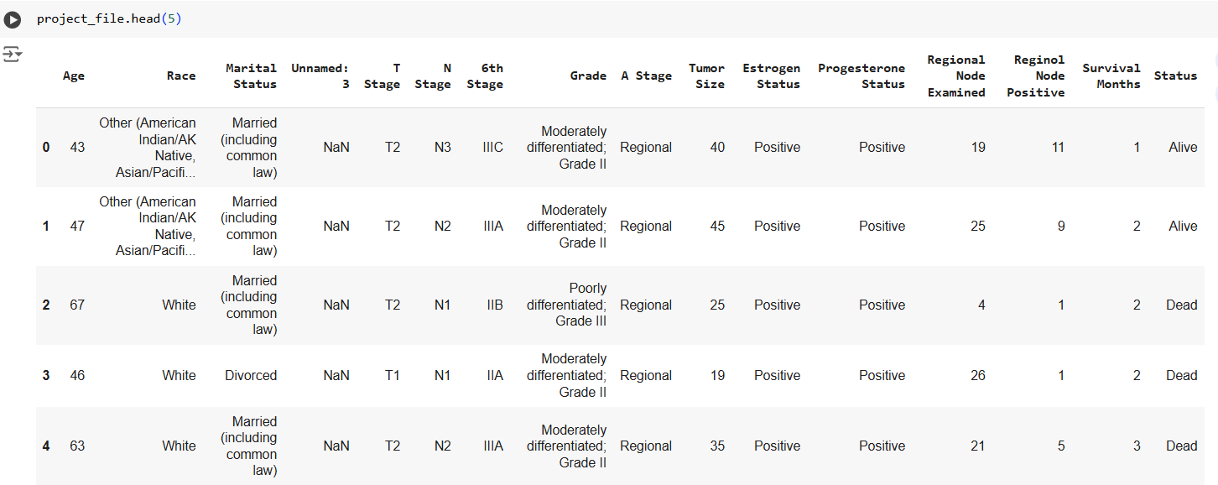
What our dataset looks like
Using the head() we have extracted the first 5 rows of the dataset:

Slide 6
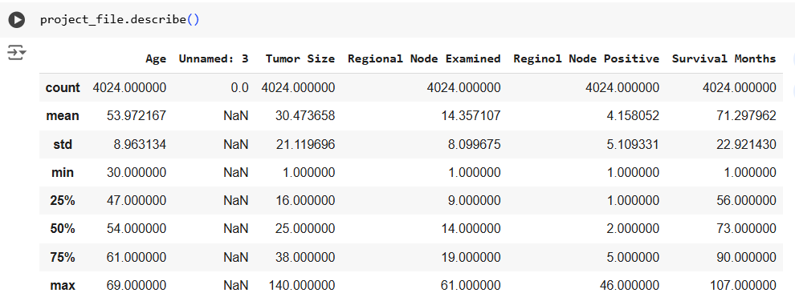
The data preprocessing will be done based on the guiding questions and what we want to analyze from the dataset
The dataset has a few missing values which will be cleaned up as part of the data wrangling

Slide 7
Summary
The data visualization will be done, again, based on the guiding questions
We should be able to visualize what the impact of each column is on the patient’s survival chances
The results obtained from this project may help clear some common misconceptions around the disease

